Slide 1


Owen Arnold
owen.arnold@tessella.com

Slide 2
VATES
Visualisation &
Analysis
Toolkit
Extensions

Slide 3
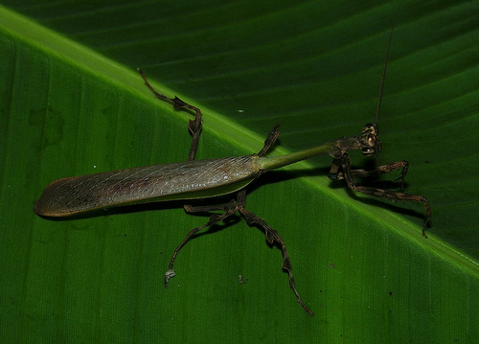
Vates pectinicornis

Slide 4
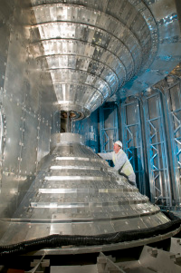
Why?
Handling new Instruments
  Highly pixelated
  Large data size
Large accumulated datasets
  Many properties of interest (highly sensitive)
  Large data space (Q,ω) or (Q,T,H,..)
  100+GB size
Consolidate Existing Knowledge
  TobyFit, Horace knowledge
  Build upon and extend Mantid
Improving the toolset for scientists

Slide 5

Project Goals
Visual Data Reduction
  Terascale Visualisation
  Exploration of nD Datasets Q(x,y,z), ω temp, field, etc
  On-the-fly rebinning of sparse data
Consolidation of Existing tools
  TobyFit, Horace knowledge
  Build upon and extend Mantid
Seamless working environment

Slide 6
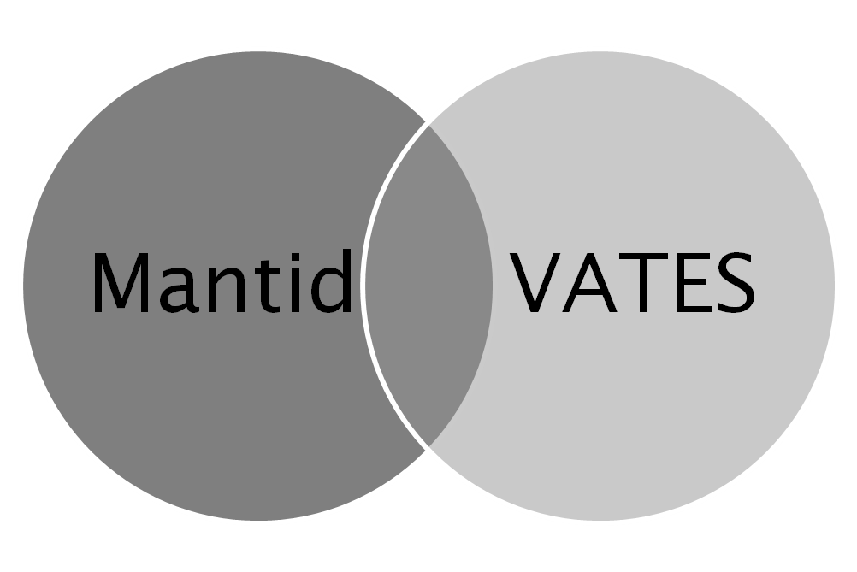
Design Choice: Mantid
Overlap in end-goals
  Overlap in common functionality

Slide 7
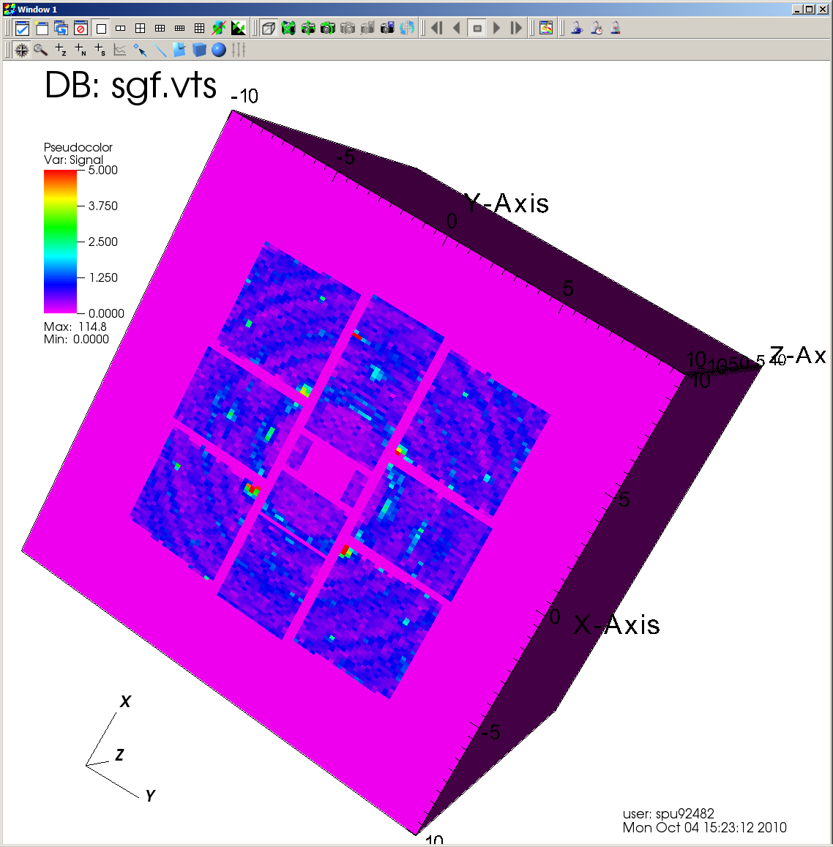
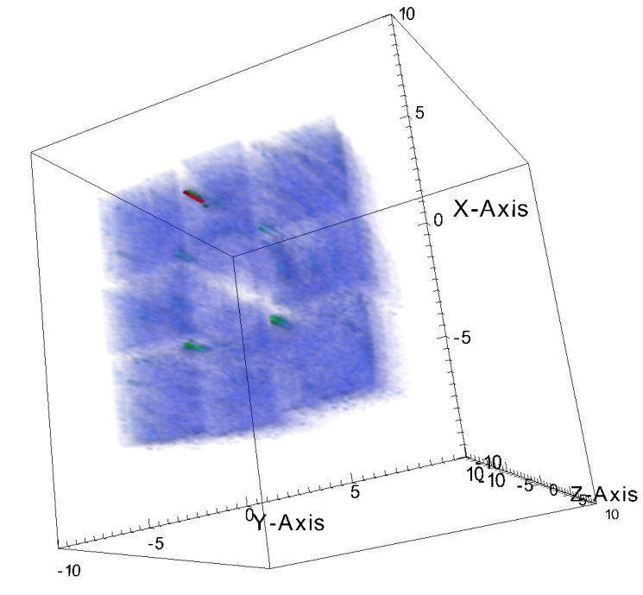
Design Choice: VisIT
Designed for scalable visualisation out-of-box
Pluggable mechanism for bespoke interaction with processing pipeline
Highly portable
Mature
Open Source

Slide 8
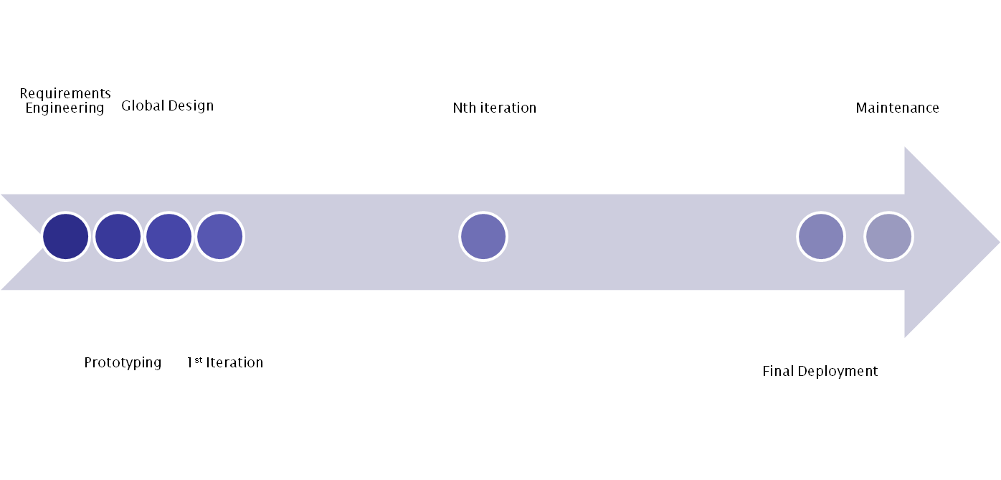
Project Plan
Year 1
Year 2

Slide 9
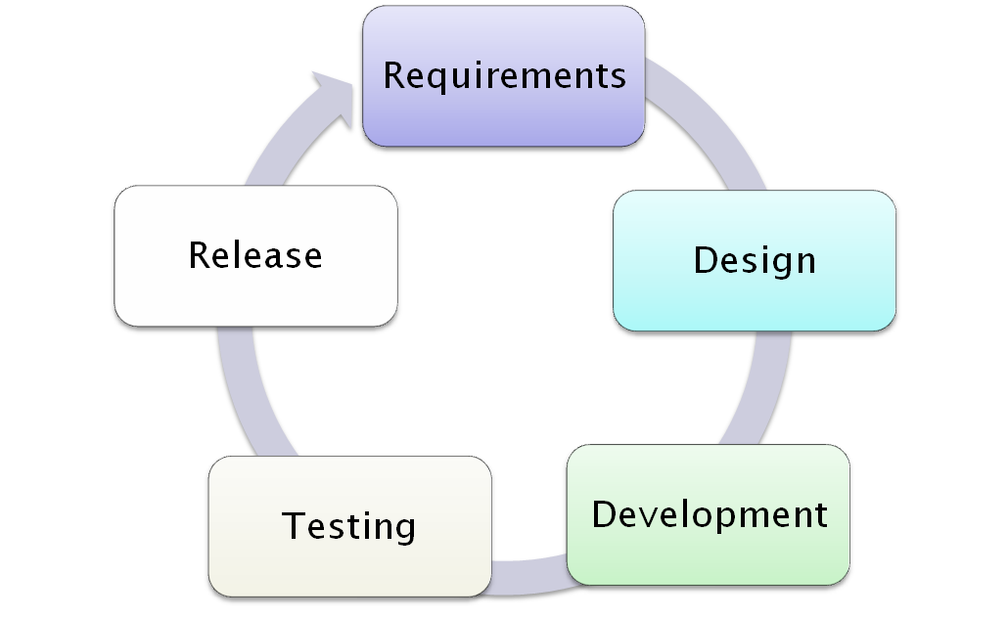
Evolutionary Development Process

Slide 10
Architectural Design - Overview
Mantid Plot
Mantid Framework
VATES UI
Algorithms
Workspaces
API
VisIT
MD Algorithms
MD Workspaces
VisIT Operators
VisIT GUI

Slide 11
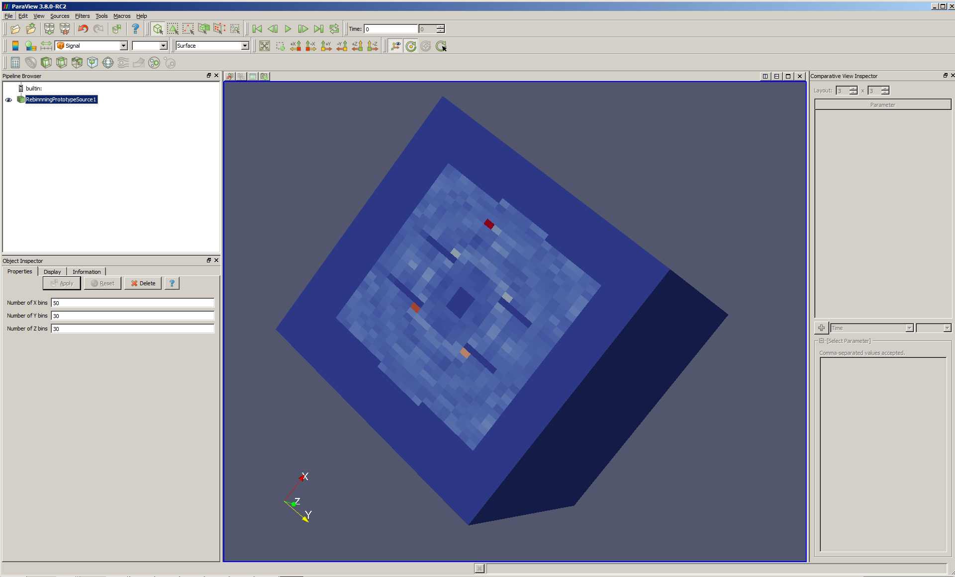
Dynamic Rebinning Prototypes

Slide 12
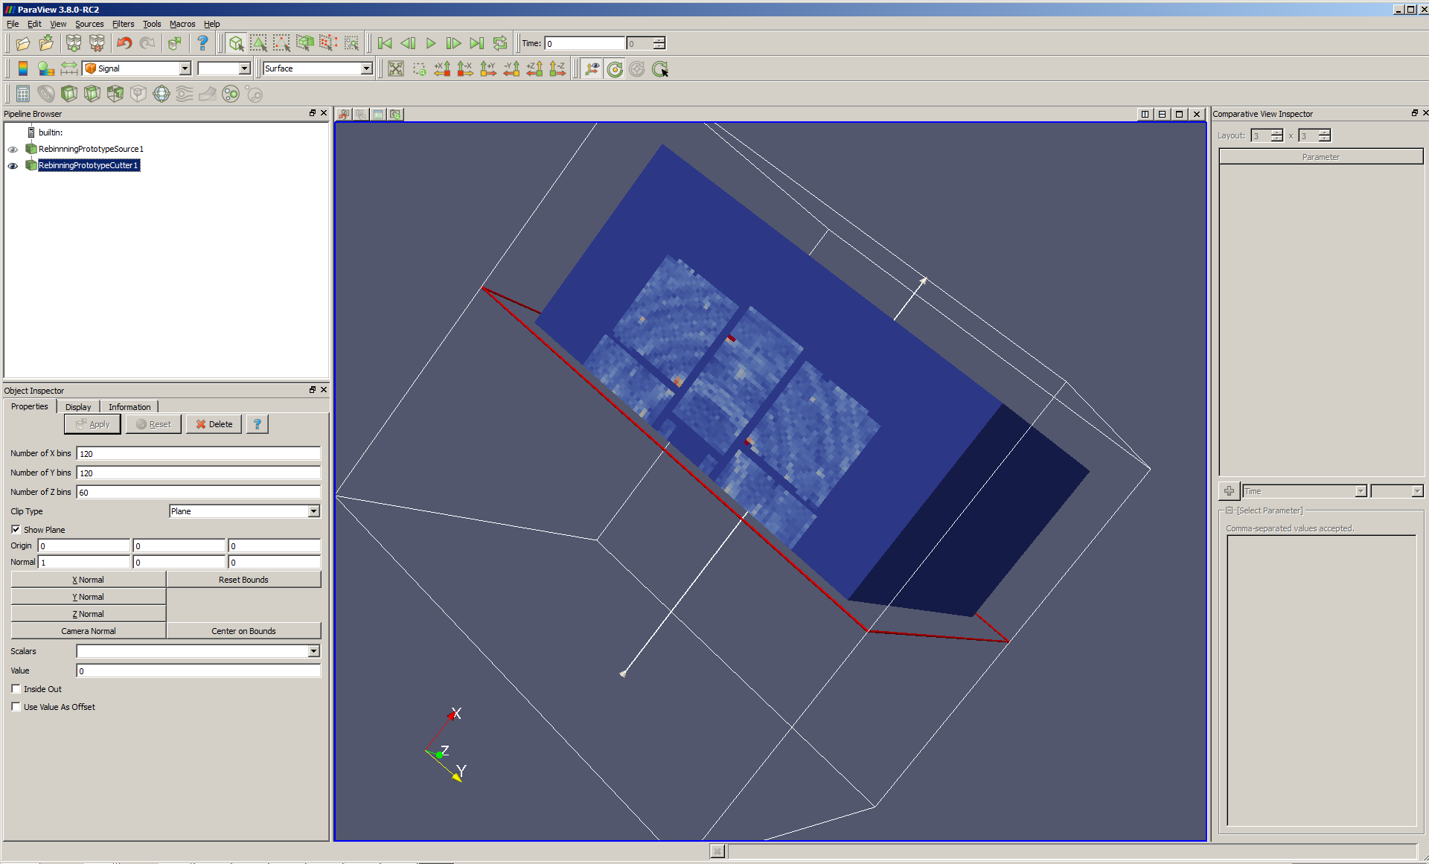
Dynamic Rebinning Prototypes

Slide 13


Visualisation Cluster
Mantid
VisIT
Mantid
VisIT
VisIT
Mantid
Mantid
VisIT
Your Laptop
Rebinning+Visualization
Servers

Slide 14
Analysis
Visualisation specifies cuts
  Multi dimensional cut operations expressed in a hierarchical format
Tobyfit
  Simulate spectrum from model sqw model
  Generate resolution function according to user defined sqw model
  Optimise predicted scattering results to experimental scattering results by modifying model parameters
Third Party Packages
  McPhase, CASTEP, GULP
  Optimise parameters in 3rd party model

Slide 15
Analysis Cluster
Mantid
Mantid
Mantid
Mantid
Your Laptop

Slide 16
Further Information
Project Web Page
  www.mantidproject.org
User Requirements Document
  http://svn.mantidproject.org/mantid/trunk/Documents/Requirements/Visualisation_and_Analysis/Visualisation_and_Analysis_URD.doc
Architectural Design Document
  http://svn.mantidproject.org/mantid/trunk/Documents/Design/VATES/VA_ADD.doc
  owen.arnold@tessella.com

Slide 17
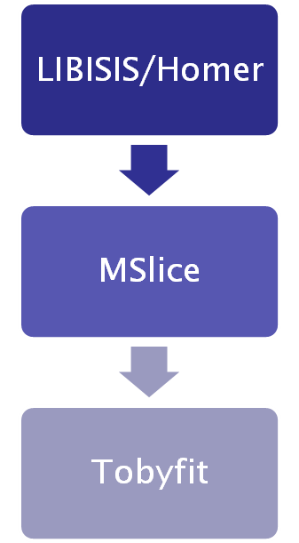

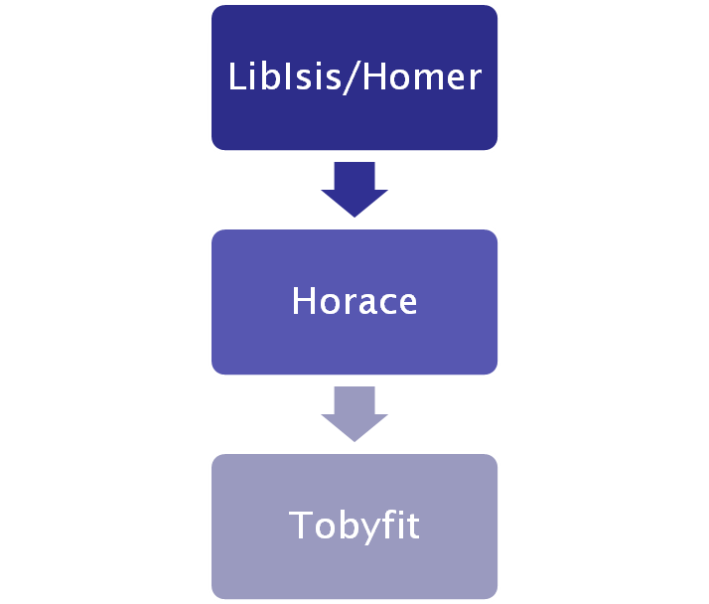
Application History
Past
Current
Future
Reduction
Slicing
Analysis

Slide 18
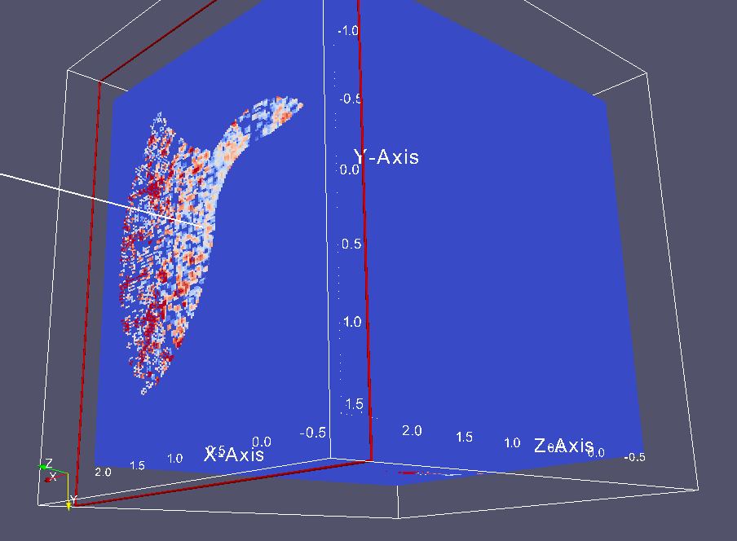

Multidimensional data visualisation

